Slide 1
Poetic Devices in Everyday Life

Slide 2
allusion
metaphor
alliteration
onomatopoeia
symbol
setting
simile
hyperbole
personification
1.

Slide 3
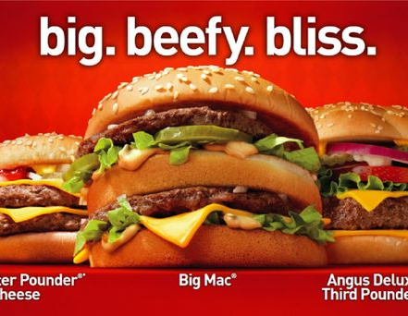
allusion
metaphor
alliteration
onomatopoeia
symbol
setting
simile
hyperbole
personification
2.

Slide 4
allusion
metaphor
alliteration
onomatopoeia
symbol
setting
simile
hyperbole
personification
3.

Slide 5
4.
allusion
metaphor
alliteration
onomatopoeia
symbol
setting
simile
hyperbole
personification

Slide 6
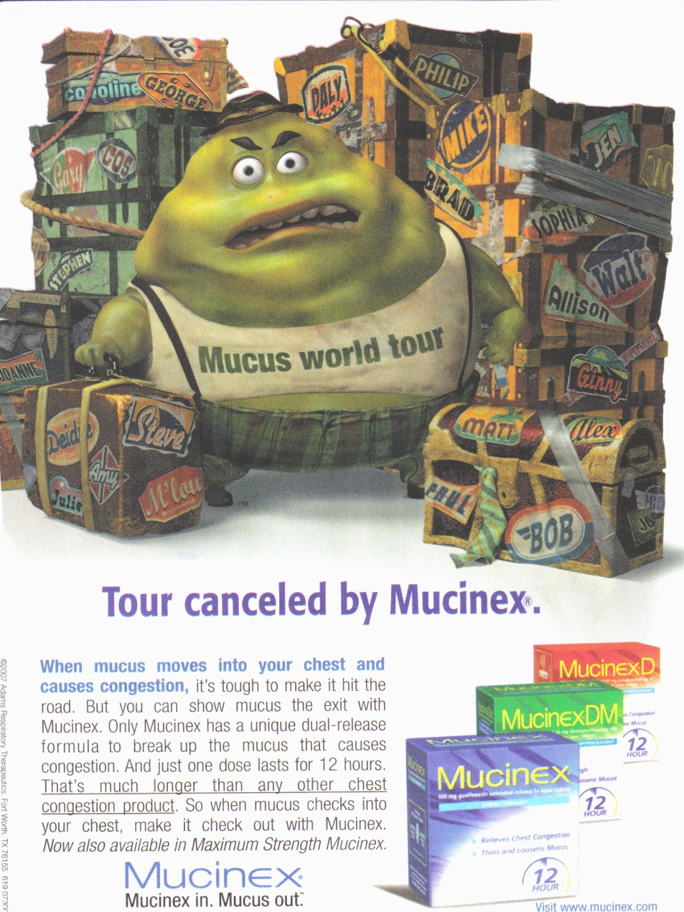
5.
allusion
metaphor
alliteration
onomatopoeia
symbol
setting
simile
hyperbole
personification

Slide 7
allusion
metaphor
alliteration
onomatopoeia
symbol
setting
simile
hyperbole
personification
6.

Slide 8
7.
allusion
metaphor
alliteration
onomatopoeia
symbol
setting
simile
hyperbole
personification

Slide 9
allusion
metaphor
alliteration
onomatopoeia
symbol
setting
simile
hyperbole
personification
8.

Slide 10
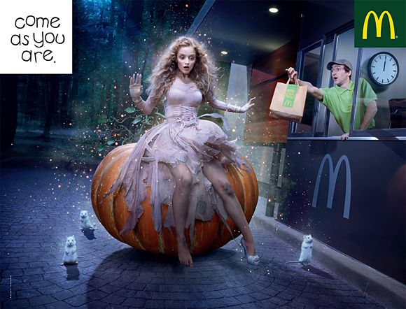
9.
allusion
metaphor
alliteration
onomatopoeia
symbol
setting
simile
hyperbole
personification

